Slide 1
Basic Electrical and Electronics Engineering
Dr. Sonam Shrivastava/ Assistant Professor (Sr.) /SELECT
LECTURE 1. 5

Slide 2
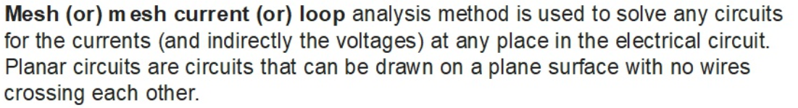
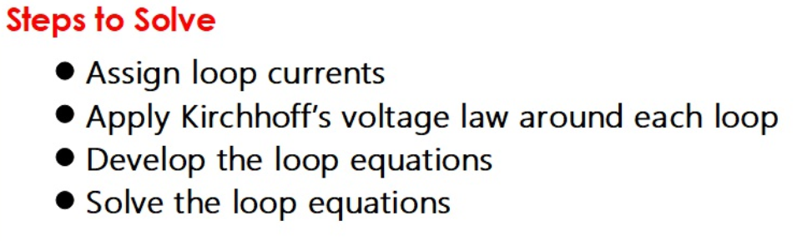
Mesh current analysis-KVL

Slide 3
Voltages from Mesh Currents
+
V_{R}
–
+
V_{R}
–
I₂
R
R
I₁
I₁
V_{R} = I₁ R
V_{R} = (I₁ - I₂ ) R

Slide 4
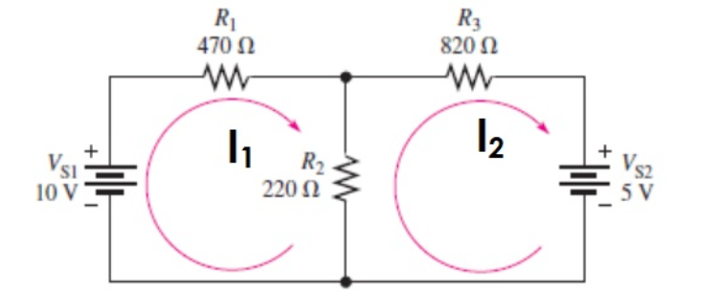
QUESTION

Slide 5


QUESTION
$$i_{1}=13.9mA$$
$$i_{2}=−1.87mA$$

Slide 6
Simple Circuit
1kΩ
1kΩ
+
+
–
+
–
V₁
V_{out}
1kΩ
V₂
–
Find V_{out} .

Slide 7
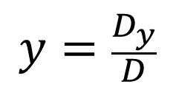

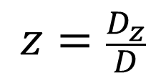
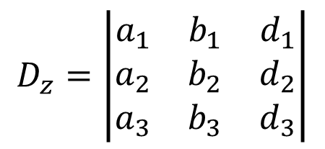
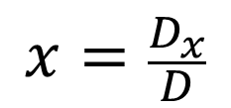
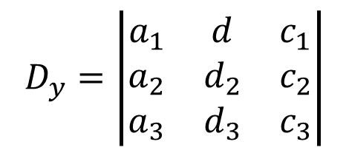

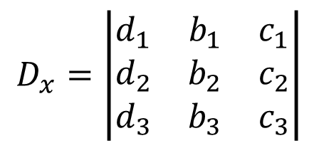

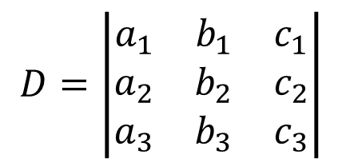
Using Cramer’s Rule to Solve Three Equations with Three Unknowns
$$a_{1}x+b_{1}y+c_{1}z=d_{1}$$
Cramer’s Rule
$$a_{2}x+b_{2}y+c_{2}z=d_{2}$$
$$x=\frac{D_{x}}{D}$$
$$y=\frac{D_{y}}{D}$$
$$z=\frac{D_{z}}{D}$$
$$a_{3}x+b_{3}y+c_{3}z=d_{3}$$
where
$$D=\left|\begin{matrix}a_{1} & b_{1} & c_{1} \\ a_{2} & b_{2} & c_{2} \\ a_{3} & b_{3} & c_{3}\end{matrix}\right|$$
$$D_{x}=\left|\begin{matrix}d_{1} & b_{1} & c_{1} \\ d_{2} & b_{2} & c_{2} \\ d_{3} & b_{3} & c_{3}\end{matrix}\right|$$
$$D_{y}=\left|\begin{matrix}a_{1} & d & c_{1} \\ a_{2} & d_{2} & c_{2} \\ a_{3} & d_{3} & c_{3}\end{matrix}\right|$$
$$D_{z}=\left|\begin{matrix}a_{1} & b_{1} & d_{1} \\ a_{2} & b_{2} & d_{2} \\ a_{3} & b_{3} & d_{3}\end{matrix}\right|$$

Slide 8
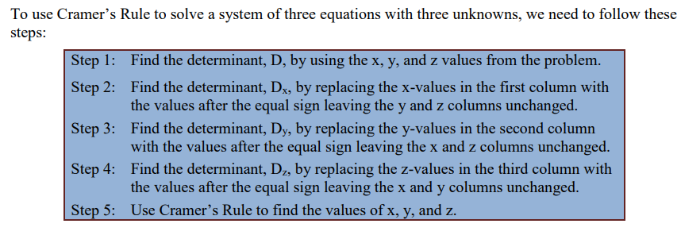
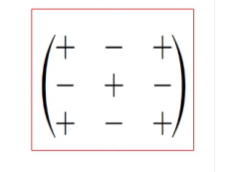
Using Cramer’s Rule to Solve Three Equations with Three Unknowns
For determinant

Slide 9
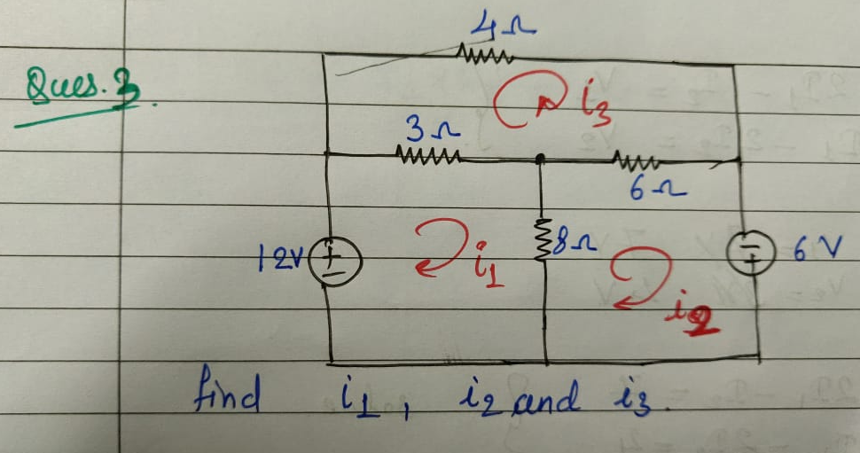
QUESTION

Slide 10



QUESTION
$$i_{1}=6.9A$$
$$i_{2}=6.3A$$
$$i_{3}=4.5A$$

Slide 11
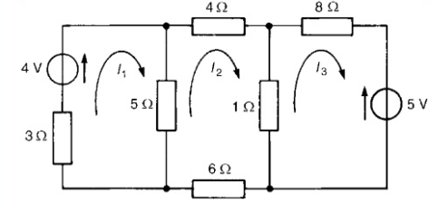


$$i_{x}$$
$$i_{y}$$
QUESTION

Slide 12
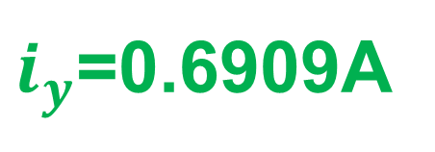
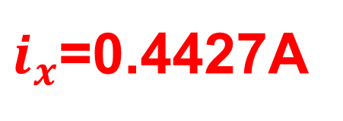
$$i_{x}$$
$$i_{y}$$
QUESTION
$i_{x}$=0.4427A
$i_{y}$=0.6909A

Slide 13

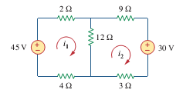
QUESTION

Slide 14
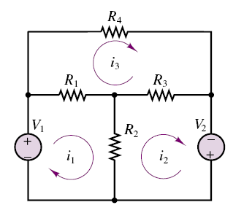



Problem. Using the mesh current method, find the loop currents.
V₁ = 12 V; V₂ = 6 V;
R₁ = 3 ; R₂ = 8 ; R₃ = 6 ; R₄ = 4 .
From loop 1
From loop 2
I1 = 6.9 A
I2 = 6.3 A
I3 = 4.5 A
From loop 3

Slide 15
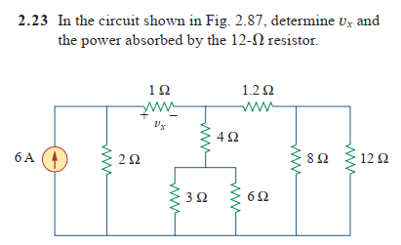

Slide 16
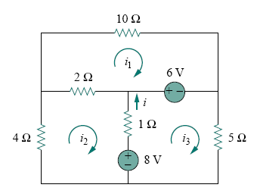
Problem: Apply mesh analysis to find i in Fig.
Ans: i=1.188 A

Slide 17
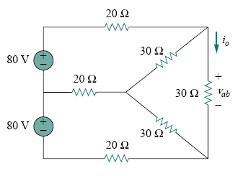
Problem. Use mesh and nodal analysis to find vab and io in the circuit in Fig.
I1 = 2.66 A I2 = 2.66 A I3 = 1.78A Vab = 53.3 V

